Slide 1
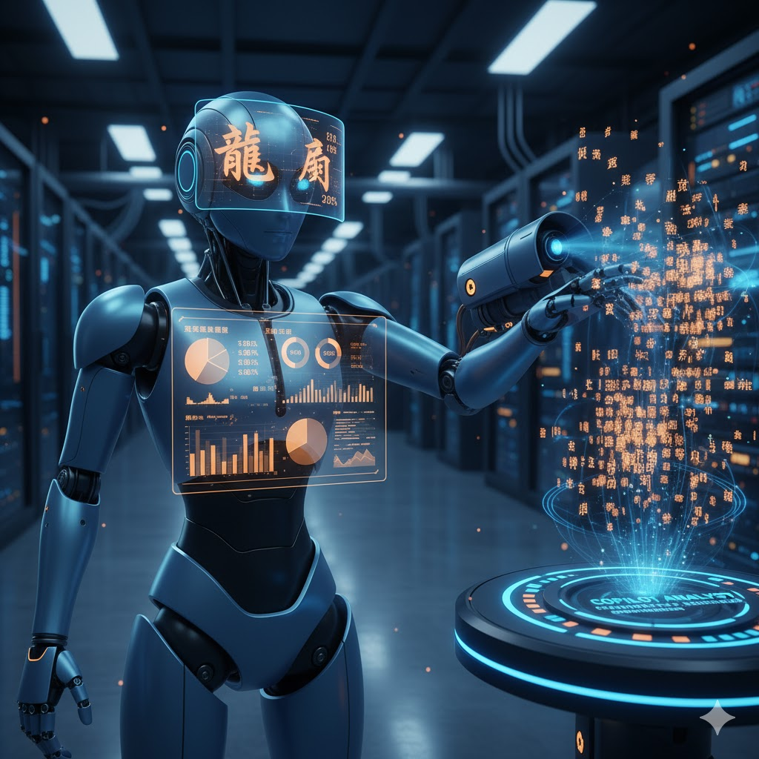


Agentic AI for Reproducible Language Science
From Prompt to Pipeline
Shane Lindsay
University of Hull
github.com/shanelindsay/agentic-r
s.lindsay@hull.ac.uk

Slide 2
OVERVIEW
Agenda
Why agentic AI matters right now
Defining agents and their toolkit
Demo: reproducible research with agents
Patterns and practices you can reuse
Focus on AI for quantitative data analysis + reporting

Slide 3
SETTING THE STAGE
Pre-requisites
Familiarity with LLM chatbots such as ChatGPT
Comfortable with R (ideas apply to Python and beyond)
Curiosity to explore 探索未至之境 - discovering what lies ahead

Slide 4


Slide 5

DEFINITIONS
What Is an Agent?
A general-purpose genAI LLM embedded in a computing environment
Reads and writes files, runs bash (linux) or PowerShell (Windows), calls APIs
Can run on local machine or in cloud container
Operates (semi)-autonomously in scoped windows (approx. 20 minutes)
Searches, codes, executes, documents - linked into full research loops

Slide 6
CONTEXT
Why Agents Now
Latest LLMs now handle multi-step, tool-rich workflows
Substantial progress in capability 2025 (and last 3 months)
Usage costs now fit student and lab budgets
Agents use a lot of tokens, hence expensive
Interfaces are accessible beyond specialist teams
Provocation: By the end of 2025 nobody needs to code or launch SPSS ever again

Slide 7

PRACTICALITIES
What Does It Cost?
One dial: fast and dumb versus slow and smart
Heavy daily use approx. $200 per month (codex, grok, claude)
Moderate schedules approx. $100 per month
Light exploration approx. $20 per month, plus free starter tiers
Cheaper options <$20 per month

Slide 8
ECOSYSTEM
Example Agent Models and Platforms
US: Codex (OpenAI), Claude Code (Anthropic), Gemini (Google), Cursor, Copilot
China: Kimi K2 (thinking), Qwen 3, GLM 4.6, Mini-max M2
Today:
Codex leads for capability, Claude Code 4.5 close
GLM/K2 offer best value

Slide 9

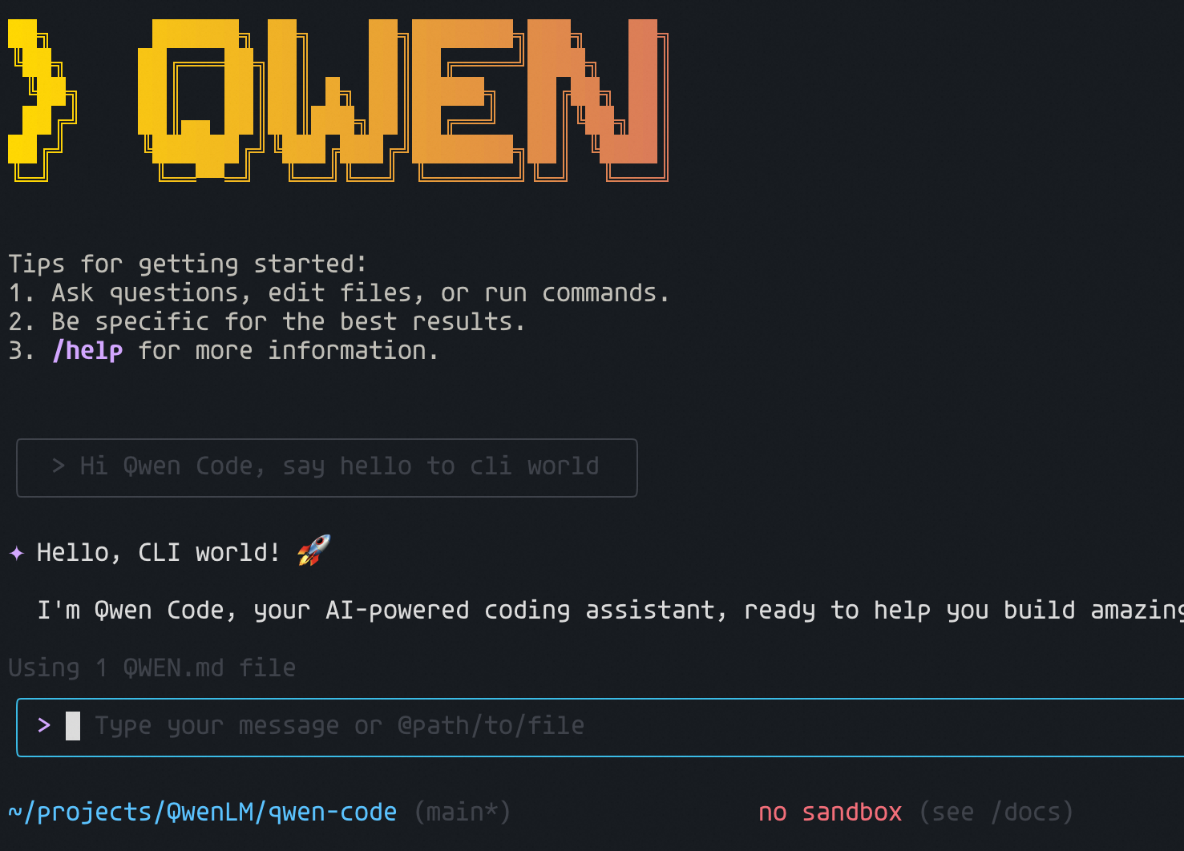
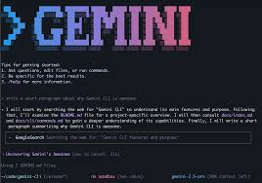

Slide 10



Slide 11
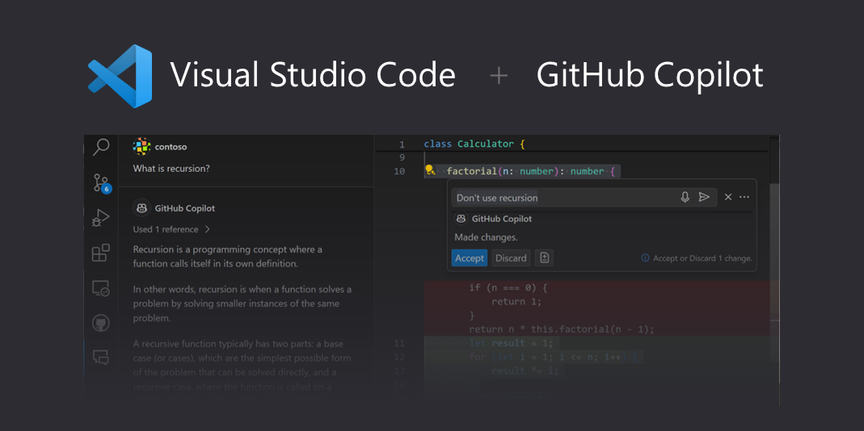

Slide 12
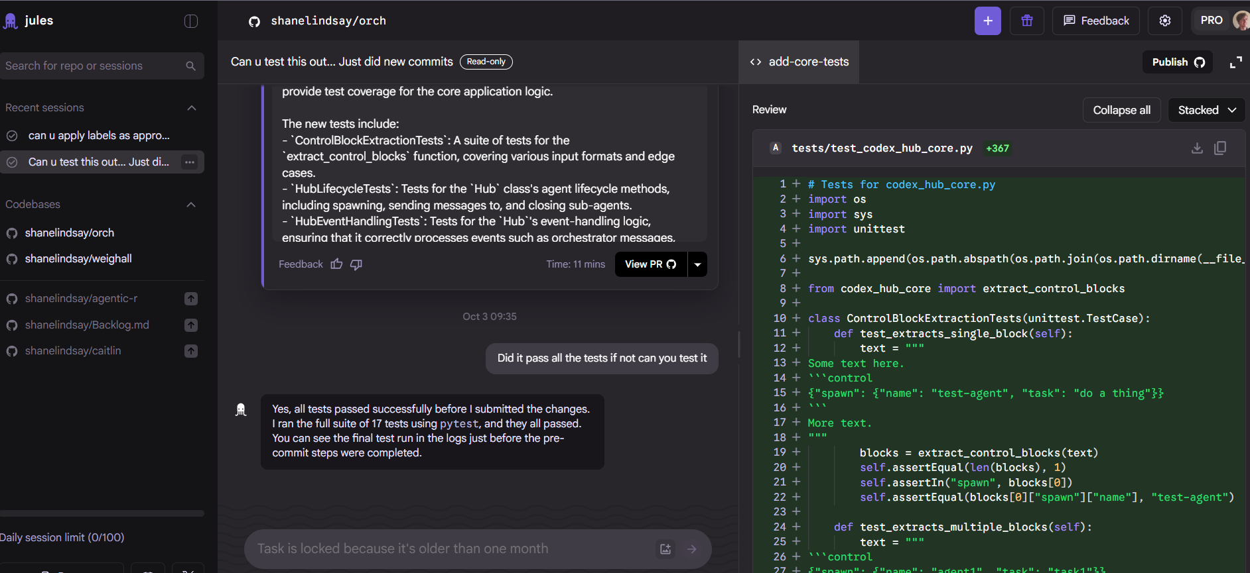
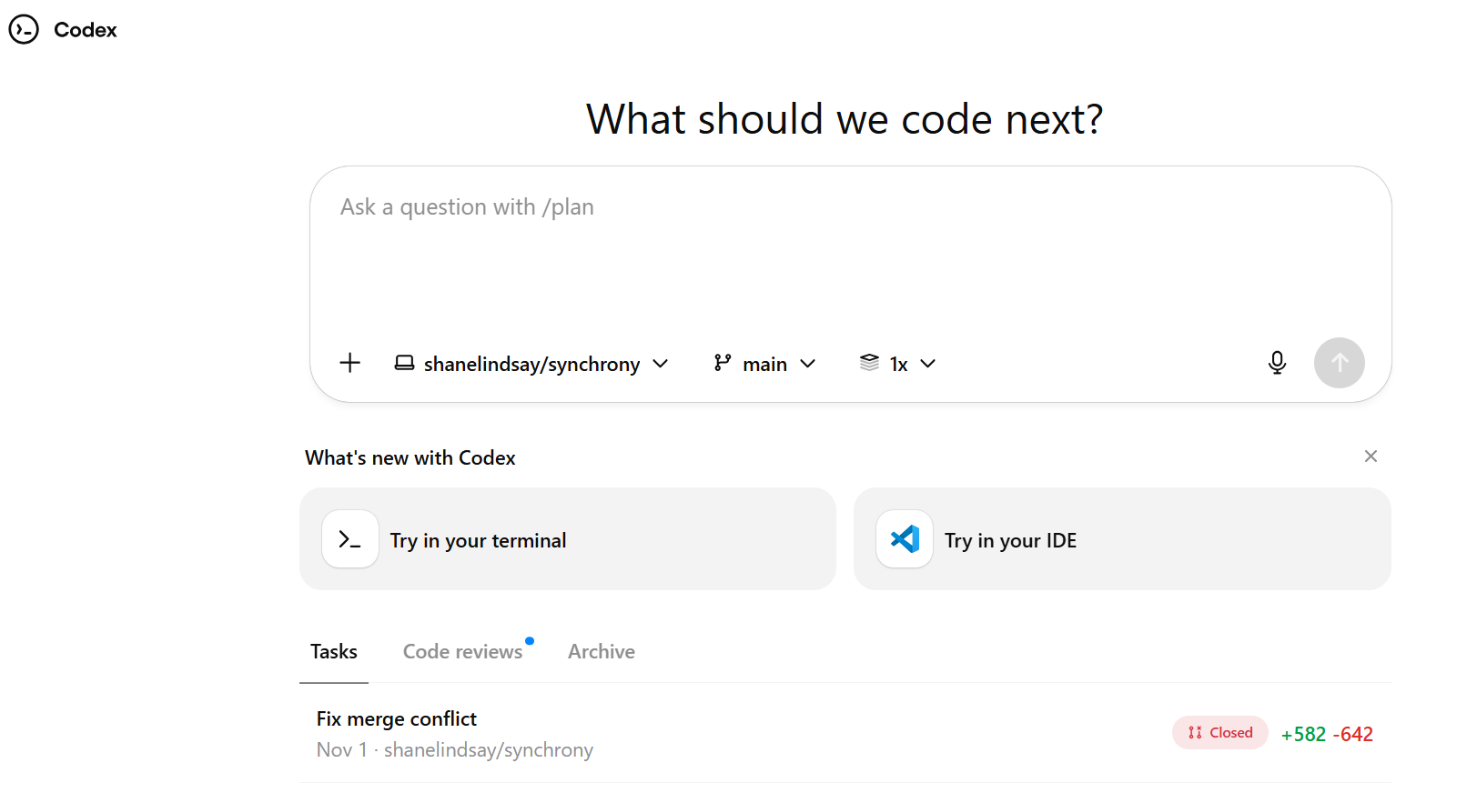

Slide 13
TRADE-OFFS
Promise and Perils
Promise
Perils
Do more! More quickly!
Accelerate analysis and reporting
Extend what individuals and small teams can deliver
Lower activation energy for ambitious workflows
Hallucinations errors still happen (though much rarer)
Risk of diffusing responsibility and losing oversight
Skill atrophy when agents replace deliberate practice
New operational complexity and tech debt

Slide 14
MINDSET
Working With Agents
Treat agents like new lab members: eager, fast, occasionally wrong
Structure projects so someone new can run them end to end
Use guardrails & approvals,
Invest in project hygiene - structure unlocks reliable automation
Best practices for agents = best practices for science + reproducible research

Slide 15
PRINCIPLES
Why Reproducible Research?
Follows the “replication crisis” in psychology
Enable peers to verify findings and build on your work
Increase transparency, reduce hidden biases
Spot errors earlier via shared, reviewable workflows
Preserve institutional knowledge beyond any one researcher
Align with funder and journal expectations

Slide 16
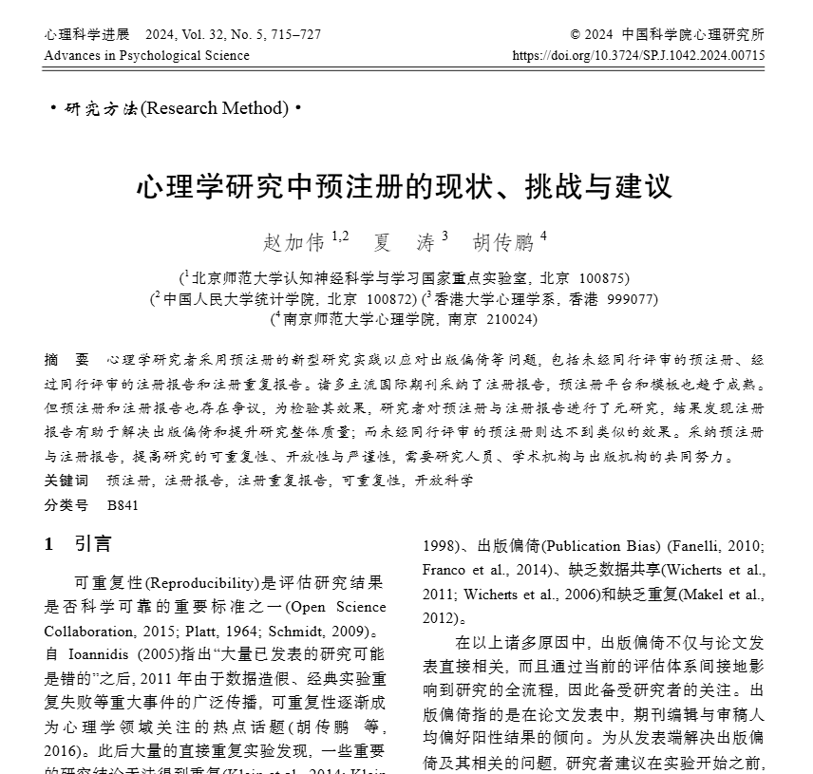
SYNERGY
Reproducible Science in China
Grass-roots: Chinese Open Science Network growing ECR-led community
CAS Open Science for Psychology, pre-print and data sharing
Zhao, J., et al. (2024). The status quo, challenges, and recommendations of preregistration in psychological science (in Chinese). Advances in Psychological Science

Slide 17
PRINCIPLES
Why Reproducible Research + Agents?
Working with Agents should be done in-line with principles of reproducible science
Any agent-augmented analysis should be checked and reproducible

Slide 18
INFRASTRUCTURE
Containers: Predictability and Security
Containers give every run the same starting point
Agents are stateless - containerised runs keep them grounded
If a colleague can run the repo from docs, an agent can too
Containers keep agents isolated (from file-system and/or web)

Slide 19
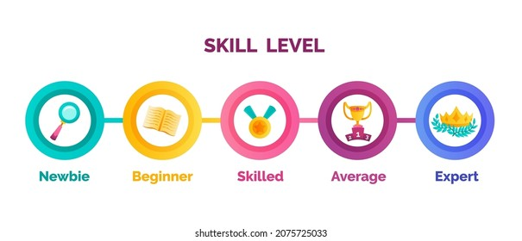
DESIGN PATTERNS
Good practices
How Code Structure Evolves
Monolithic scripts: fast to start, fragile, opaque when something breaks
Numbered scripts: clearer modularity, easier to rerun sections
Makefile pipelines: explicit dependencies, deterministic outputs - press go to reach the manuscript

Slide 20
COLLABORATION
GitHub + Agents
Agents often strongly linked to github
Version history protects work and surfaces diffs automatically
Agents operate via CLI; humans can review in IDE or web
Pull requests keep you in the approval loop

Slide 22
CASE STUDY
Inside agentic-r
AGENTS.md is the handbook for humans and agents
dev/run-in-env.sh wraps R sessions with micromamba
environment.yml pins R version and packages

Slide 23
├── .gitignore
├── .here
├── AGENTS.md
├── Makefile
├── README.md
├── environment.yml
│
├── R/
│ └── utils.R
│
├── configs/
│ └── cleaning.yml
│
├── data/
│ └── raw/
│
├── dev/
│ └── run-in-env.sh
│
├── docs/
│ ├── data-sources.md
│ └── ideas.md
│
├── outputs/
│ ├── data/
│ ├── deliverables/
│ ├── figures/
│ ├── reports/
│ └── results/
│
├── reports/
│ ├── .gitignore
│ ├── _quarto-profile-local.yaml
│ ├── _quarto.yml
│ └── results.qmd
│
└── scripts/
├── 01_prepare.R
├── 02_base_lm.R
└── character_frequency_effect.R

Slide 24
AGENTS.md is the handbook for humans and agents

Slide 25
dev/run-in-env.sh wraps R sessions with micromamba
environment.yml pins R version and packages
Solves big pain points with reproducible containers

Slide 26
WORKFLOW
Pipeline Overview
Makefile sequences scripts for deterministic builds
Makefile orchestrates 01_prepare.R then 02_model.R
Data flows raw -> processed -> results/metrics.yml
Quarto report reads results for publication-ready prose
Agents run everything via the environment wrapper

Slide 27
EXAMPLE STUDY
Lexical Decision in Chinese
Wang et al. (2025) Simplified Chinese Lexicon Project. Behavior Research Methods.
Sun et al. (2018) Chinese Lexical Database. Behavior Research Methods.
Agents start by running the baseline pipeline to reproduce results/metrics.yml

Slide 28
EXAMPLE STUDY
Lexical Decision in Chinese - Megastudy
8 105 characters + 4 864 pseudocharacters, ~376 000 trials
Lexical decision task: real vs pseudo character judgements
Measures reaction time, accuracy, z-scores per character
Open-access benchmark for visual word recognition in Chinese
Wang et al. (2025) Simplified Chinese Lexicon Project. Behavior Research Methods.

Slide 29
Lexical properties of Chinese
~49 000 words and 4 900 unique characters in simplified Mandarin
260 + lexical and psycholinguistic variables (e.g. frequency, strokes)
Compiled from corpora and behavioural norms
Reference set for form, meaning and familiarity in lexical research
Sun et al. (2018) Chinese Lexical Database. Behavior Research Methods.

Slide 30
AGENT DEMO
Builder Pattern
Prompt: add a predictor and rerun the report
Agent invokes wrapper scripts and Makefile targets
Pipeline regenerates outputs and report in minutes
Diff showcases exactly what changed

Slide 31
AGENT DEMO
Pull Request Review
A second agent reads the diff and writes a review
Human reviews the agent's comments and approves or requests changes
Iterative loop maintains velocity and oversight

Slide 32
PLAYBOOK
Agent Patterns to Copy
Builder: proposes and implements code changes
Checker: audits diffs, reruns tests, validates outputs
Critic: recommends diagnostics or tests when needed
Human: remains final approver and ethical backstop

Slide 33
NEXT STEPS
Where to Start
Pick one pipeline stage - cleaning, modelling, or reporting – and ask for changes
Keep tasks atomic so agents (and collaborators) can slot in
Track outputs in version control for transparent reviews

Slide 34
NEXT STEPS
The future…
Pick one pipeline stage - cleaning, modelling, or reporting – and ask for changes
Keep tasks atomic so agents (and collaborators) can slot in
Track outputs in version control for transparent reviews

Slide 35
The future…
Aspect | Doing the Work | Managing / Orchestrating
Focus | Writing code, running analyses, interpreting results | Designing workflows, assigning tasks, integrating outputs
Skills | Technical proficiency, attention to detail | Planning, coordination, system thinking
Tools | IDEs, scripts, datasets | Repos, specs, pipelines, agents
Mindset | “How do I solve this?” | “Who or what should solve this, and how do pieces fit together?”

Slide 36
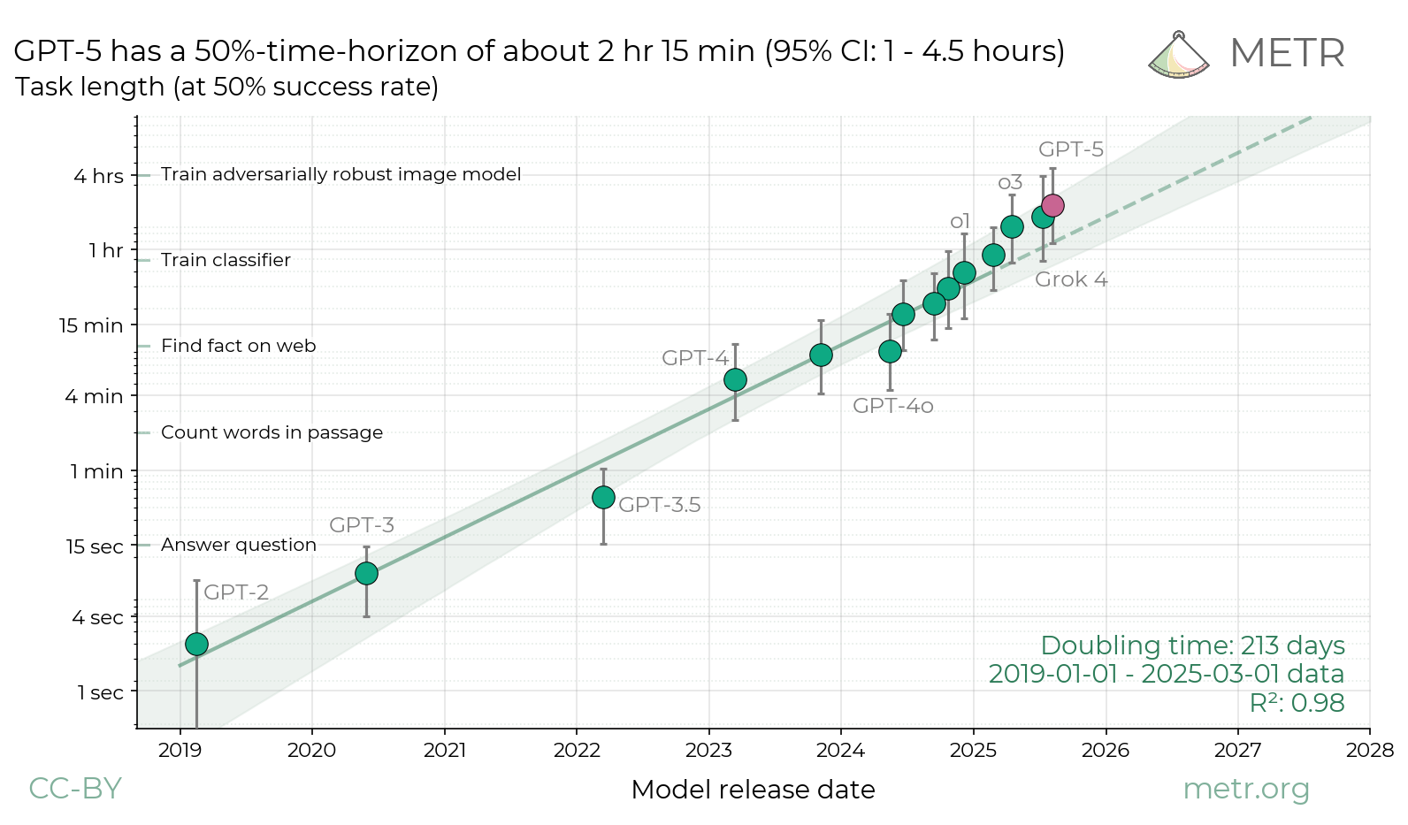

Slide 37
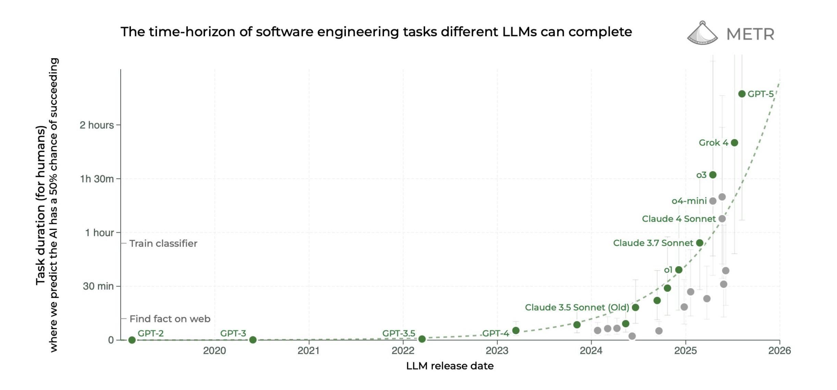

Slide 38

NEXT STEPS
The possibilities are tremendous! but

Slide 39
AGENT TALK
Agentic AI for Reproducible Language Science
From Prompt to Pipeline
Shane Lindsay
s.lindsay@hull.ac.uk
University of Hull
github.com/shanelindsay/agentic-r

